Slide 1




Anomaly recognition in citation networks using Beta Wavelet Graph Neural Network
Capstone Project Phase A
24-1-R-13
Maayan Sharvit
Supervisor: Dr. Renata Avros
Shir Cohen

Slide 2



Purpose of the project
Use the Beta Wavelet Graph Neural Network model to recognize anomaly citations in a citation network.
Train the model over the Cora dataset to achieve fine detection of irrelevant citations for each paper in the dataset.

Slide 3

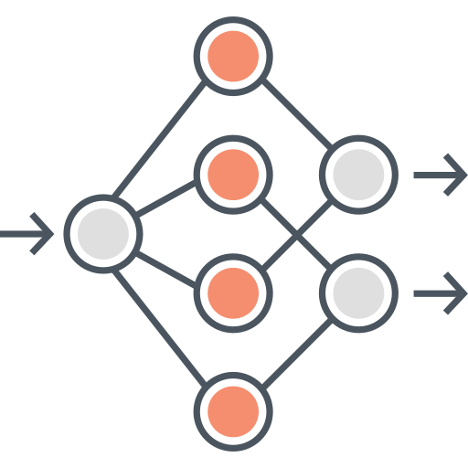
The problem using GNN
Nowadays, Graph Neural Networks are popular in data structure mining and graph error detection task.
The vanilla GNN suffers from the over smoothing problem which smoothens the deviations with each aggregation operation by GNN and therefore they are less distinct.

Slide 4
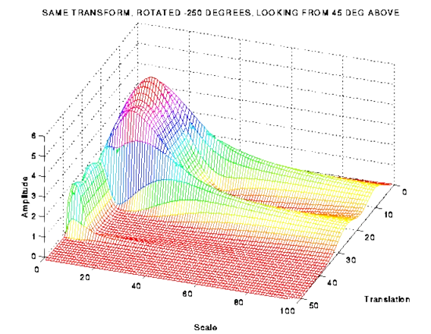
The advantages using Beta Wavelet Graph Neural Network
BWGNN suggests accessing the graph from the spectral domain instead of the spatial domain to confront the ‘right-shift’ phenomenon.
For that reason, a spectral filter needs to be tailored for addressing higher frequency anomalies via multiple flexible and band-pass filters.

Slide 5


Graph Laplacian
The Laplacian computed as:
L = D - A,
Where D is the degree matrix of the graph and A is the adjacency matrix of the graph.
Graph Laplacian determines a spectral layout of a graph and provides information about the connections between nodes.
By leveraging the Laplacian, the model can capture important patterns and characteristics of the graph signal, which can be useful for tasks such as anomaly detection.

Slide 6

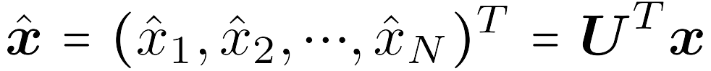
Graph Fourier transform
The Graph Fourier transform is used for filtering and spectral analysis of graphs.
It allows an understanding of a graph signal's frequency content by transforming graph signals from the spatial domain to the spectral domain.
Notes:
The Fourier transform is very common tool in math. Within our project we are going to deal with such a transform operating on graphs.

Slide 7
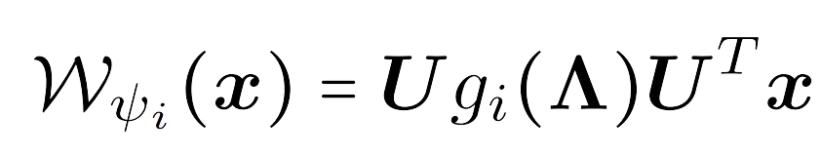
Hammond’s wavelet theory
The graph Hammond Wavelet transform utilizes a set of Wavelets with "mother" Wavelet ψ denoted as
Hammond's theory extends Wavelet analysis to graphs, using graph Wavelets as a band-pass filter in the spectral domain.
This enables the analysis of graph signals at different frequency scales.

Slide 8
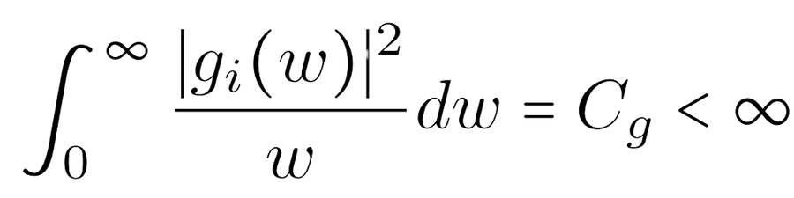
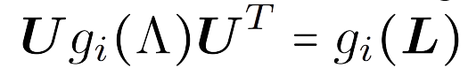
Hammond’s requirements
1
Preservation of total energy.
2
Coverage of different frequency bands.
3
Polynomial kernel function.
Notes:
1. Hammond guarantees the preservation of total energy during signal transformation, ensuring convergence to a finite value in the transformed signal's energy integral.
2. The wavelet transform covers different frequency bands via band-pass filters of different scales.
3. To avoid the need for eigen-decomposition of the graph Laplacian , the kernel function is chosen to be a polynomial function, that is
NOT ENOUGH TIME TO DIVE IN.

Slide 9

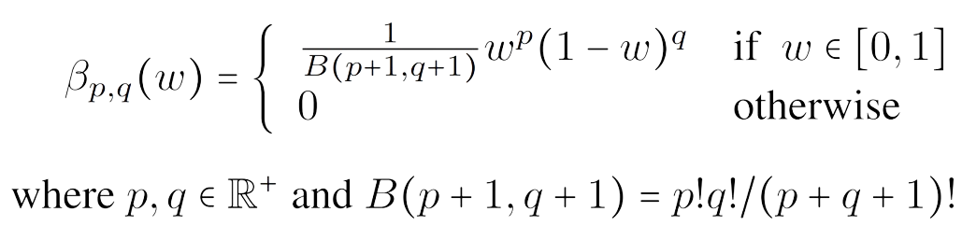
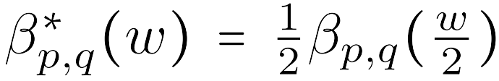

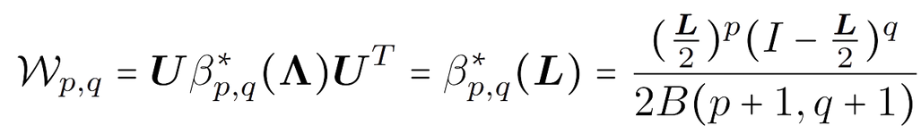
Beta Kernel Wavelet transform
By operating on the eigenvalues and eigenvectors of the Laplacian matrix, graph Beta Wavelets can capture important structural features and patterns of the graph data at different scales.
+
Notes:
The chosen graph kernel function is the Beta distribution that meets the requirements of Hammond’s graph wavelet.

Slide 10

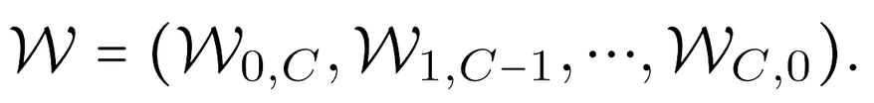

The model
BWGNN employing the Beta wavelets in parallel for each signal. These wavelets, band-pass and spectral-localized properties, excel at capturing high-frequency anomalies due to its filters who target the "right-shift" phenomenon.
The BWGNN architecture draws inspiration from Hammond's graph wavelet theory, enabling the construction of diverse band-pass filters with varying scales.
X
H
MLP
& sigmoid
loss
function
MLP
AGG
.
.
.
Where W is the Beta Wavelet transform and C + 1 is the number of scales.
C + 1

Slide 11
The flow
Prepare the dataset
Initial processing
apply MLP(X)
Aggregation
Train the model
1
2
3
4
5
6
7
8
Input X-
node features
Parallel wavelet
filtering
Anomaly score
calculation
Anomaly
detection
Notes:
לציין שנסביר בשקפים הבאים.

Slide 12
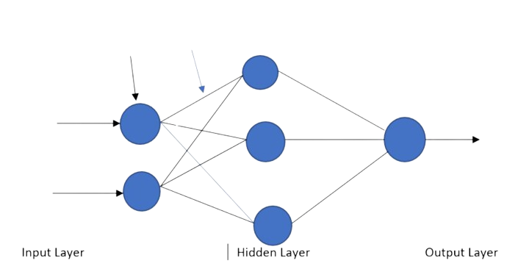
Multi-layer perceptron
First processing on the node features input is a multi-layer perceptron that captures important information about the graph's structure and attributes.
Essentially, acting as a feature extractor, the MLP extracts meaningful features from the raw input data, which are then passed on to subsequent layers for further processing and analysis.

Slide 13
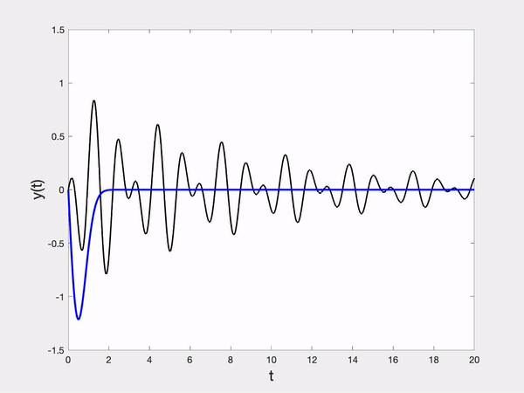
The Wavelet functions are activated to enhance the model's ability to capture localized and multi-scale information within the graph. These wavelet functions serve as filters that allow the model to focus on specific regions of the graph while analyzing it at various scales simultaneously.
Parallel wavelet filtering
By decomposing the graph signal into different frequency components using wavelets, the model can extract relevant spectral features that are indicative of anomalies.

Slide 14
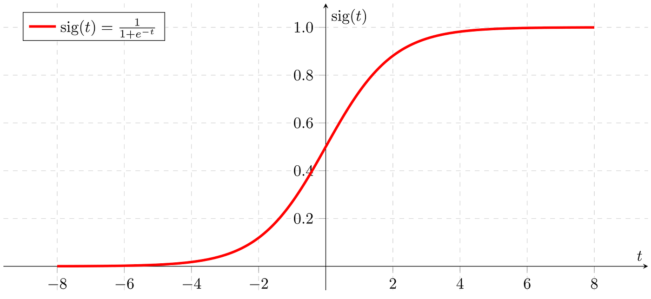
Anomalies initial evaluation
MLP with sigmoid function
The purpose of this second MLP is to further process and refine the extracted features to make a final decision regarding the presence of anomalies in the graph. The sigmoid activation function is commonly used in binary classification tasks, such as anomaly detection, where the model needs to output the abnormal probability score indicating the likelihood of each data point being anomalous.

Slide 15


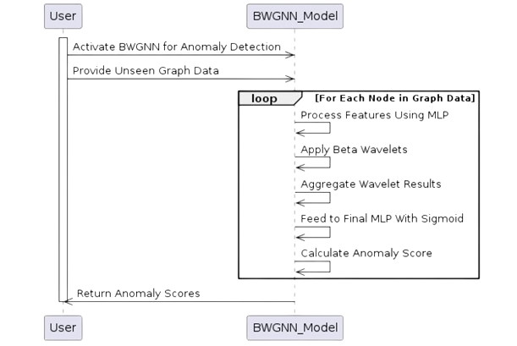
Sequence diagram

Slide 16
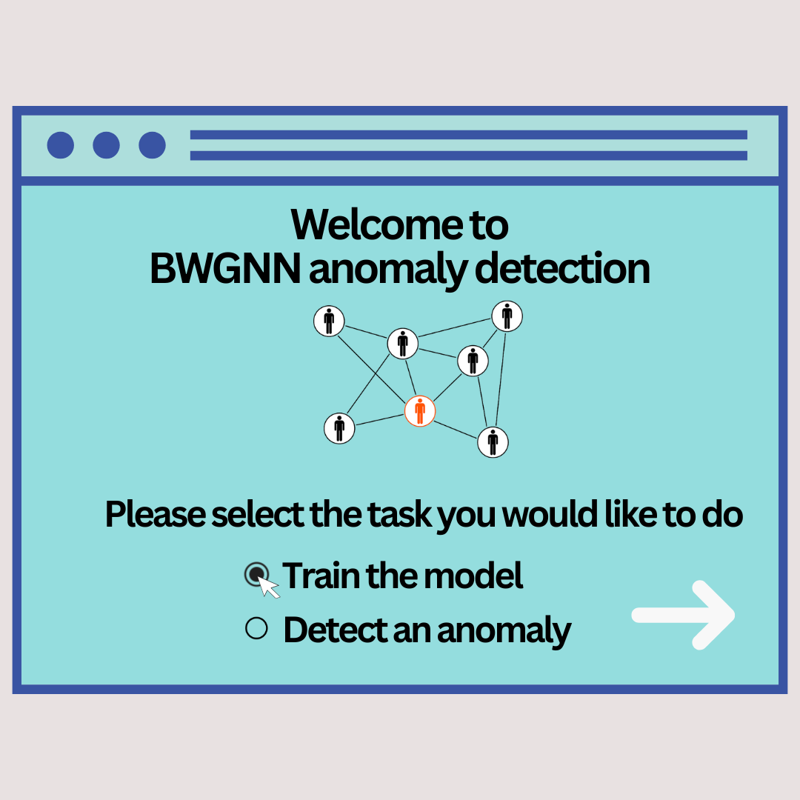
GUI

Slide 17
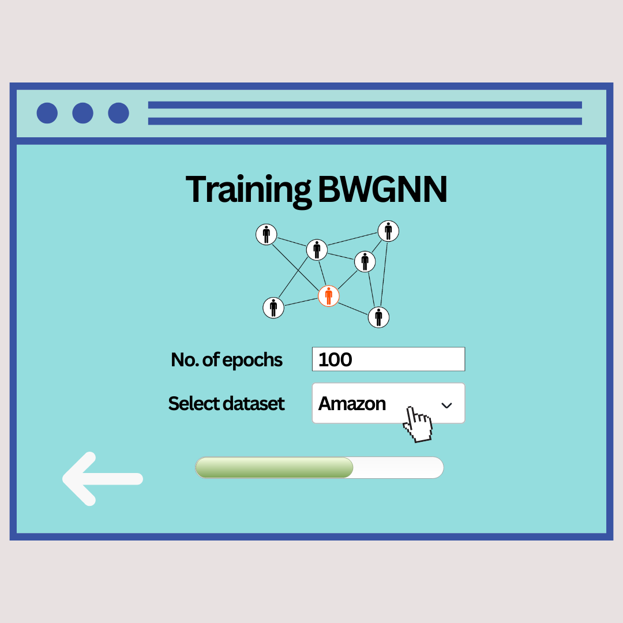
GUI

Slide 18
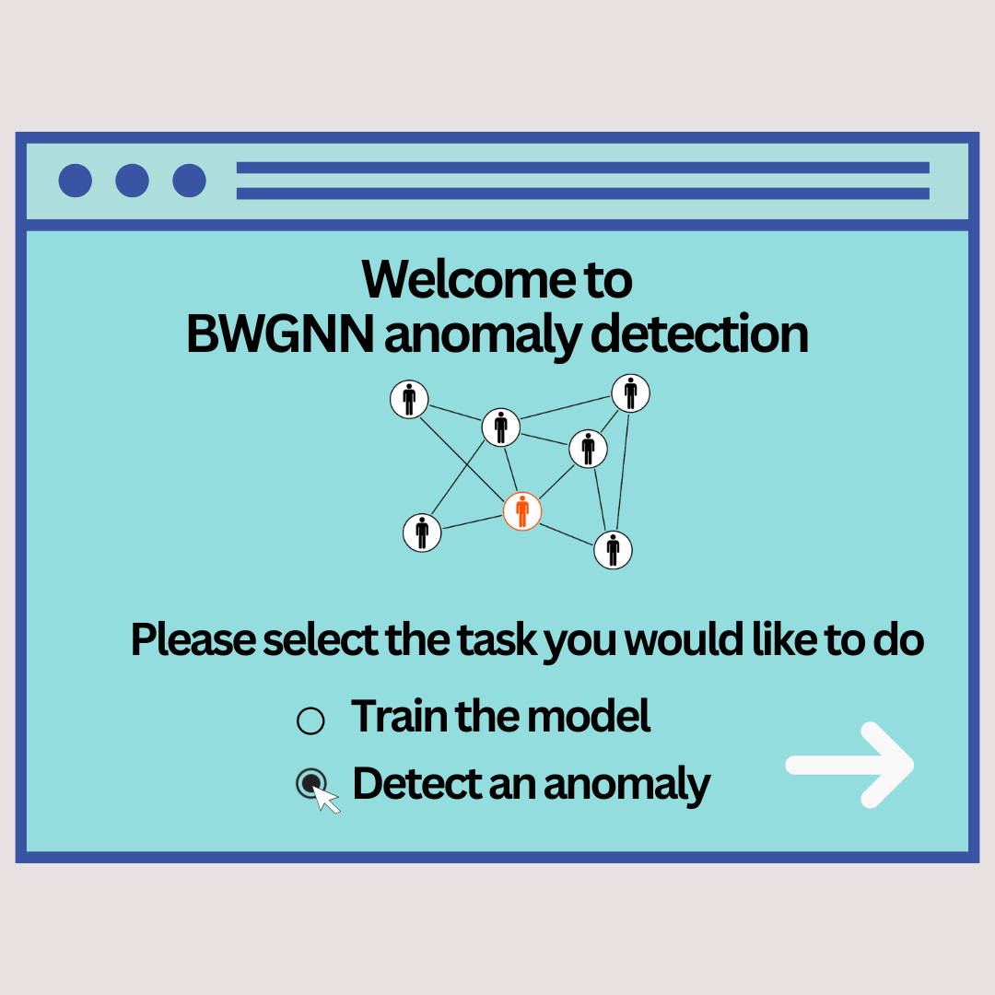
GUI

Slide 19
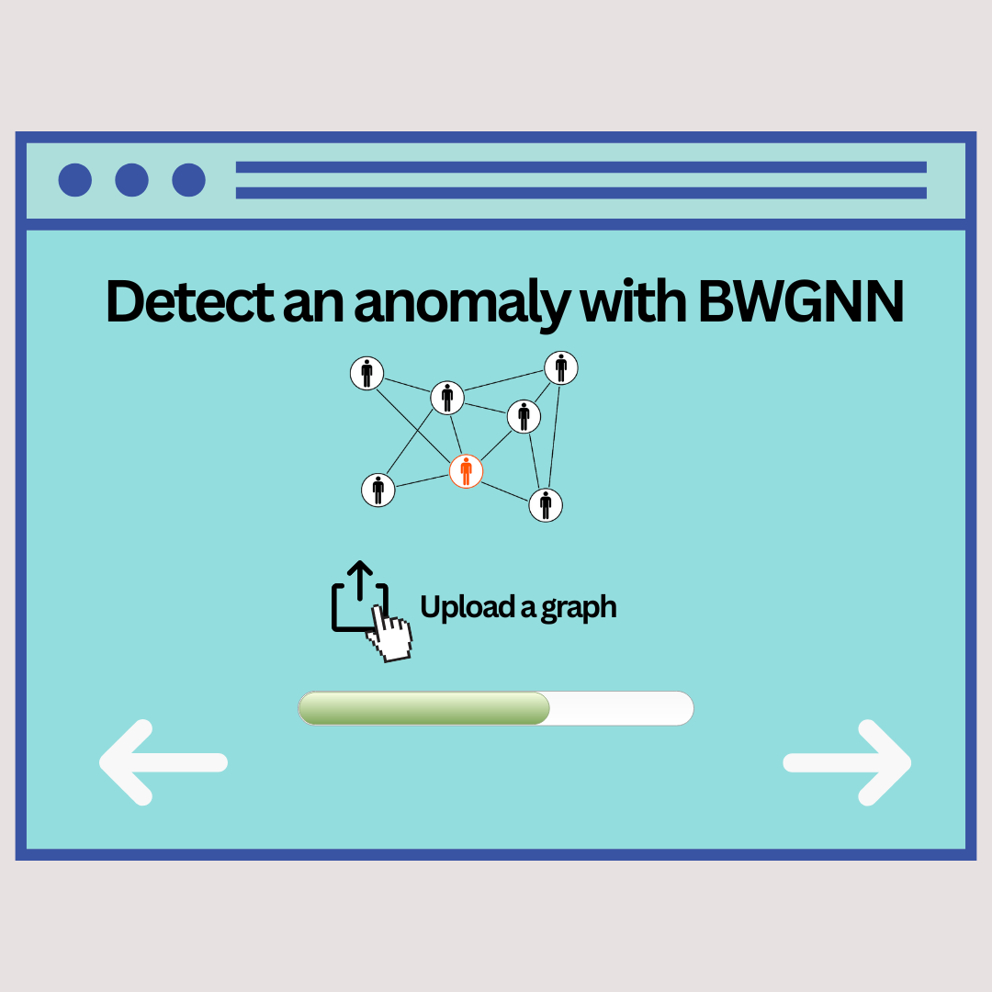
GUI

Slide 20
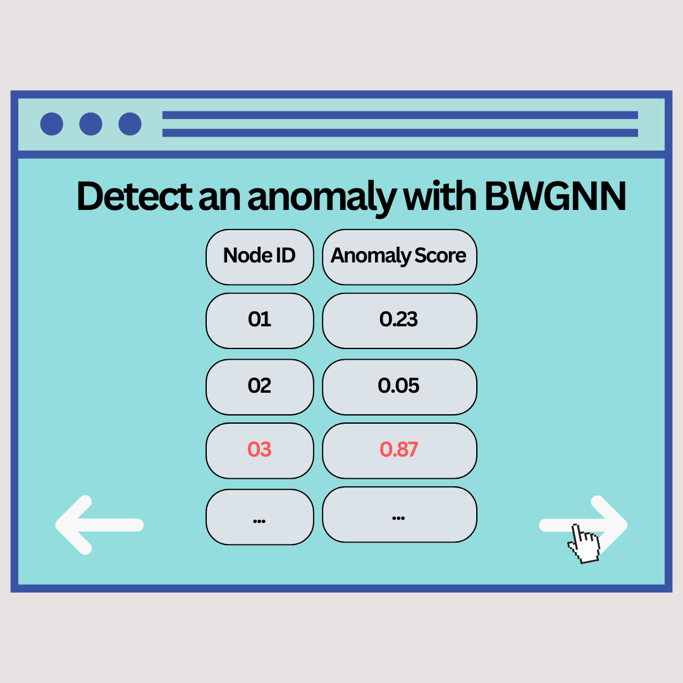
GUI

Slide 21
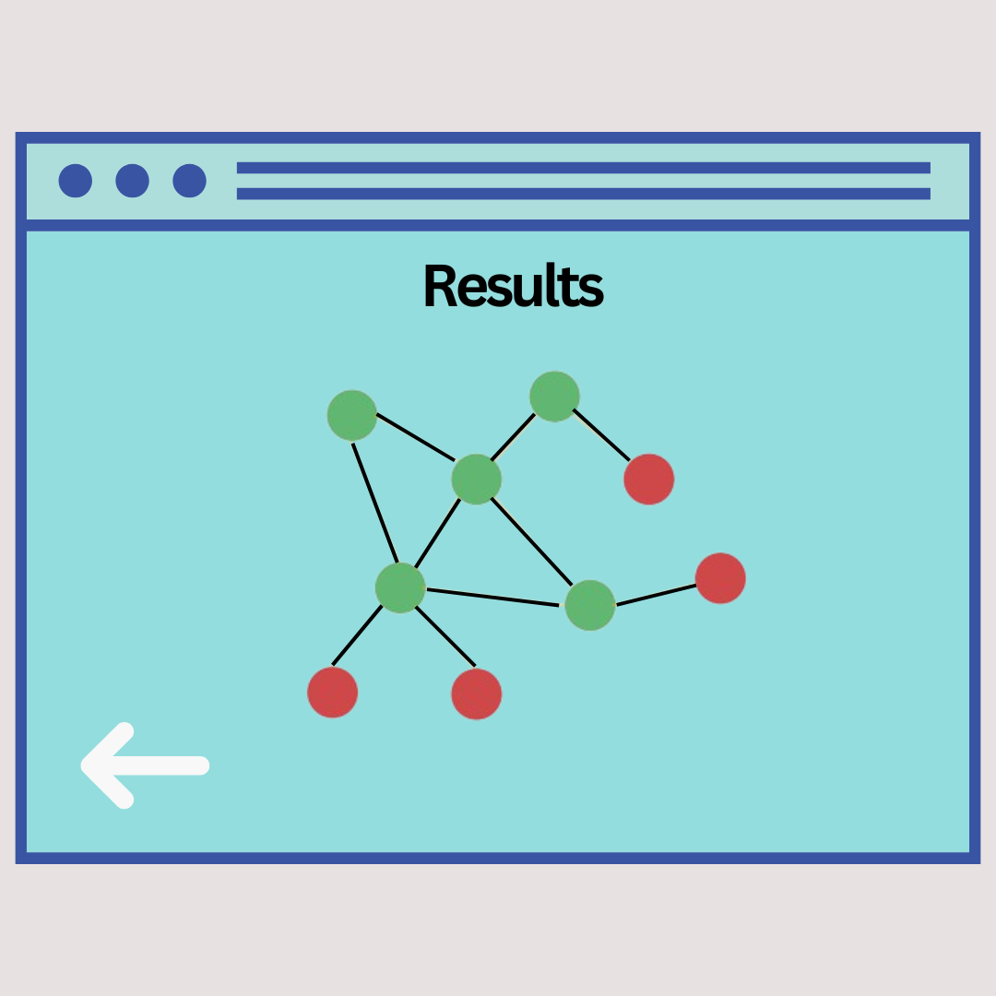
GUI

Slide 22
Case | Name | Description | Expected Output
1 | Wrong input | The input is not node features. | An error message appears on the screen.
2 | Activating anomaly detection without pre-training | The user starts using the model for anomaly detection before the model is trained. | An error message appears on the screen.
3 | Wrong aggregation result | The C Beta Wavelets results aggregated poorly and gave a wrong result. | An error message appears on the screen.
4 | Invalid value of epoch's amount variable | The input for the epoch's variable is negative. | An error message appears on the screen.
5 | Missing output | The last fails MLP and the probability prediction is not shown. | An error message appears on the screen.
Verification plan

Slide 23
THANK YOU
hope you enjoed

